Slide 1
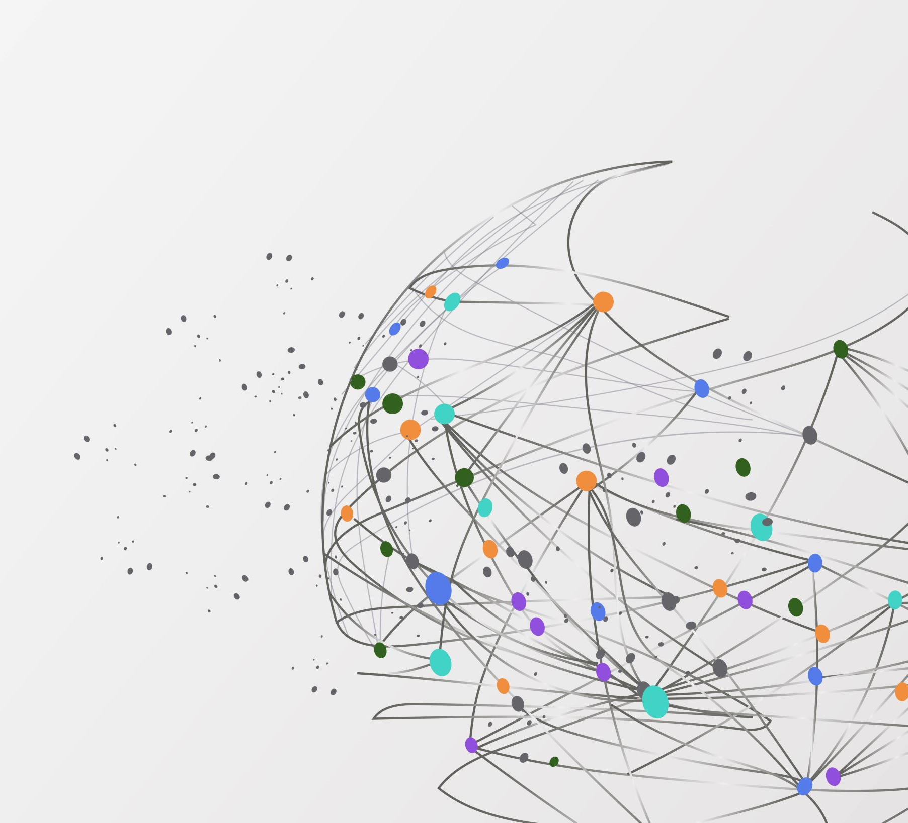
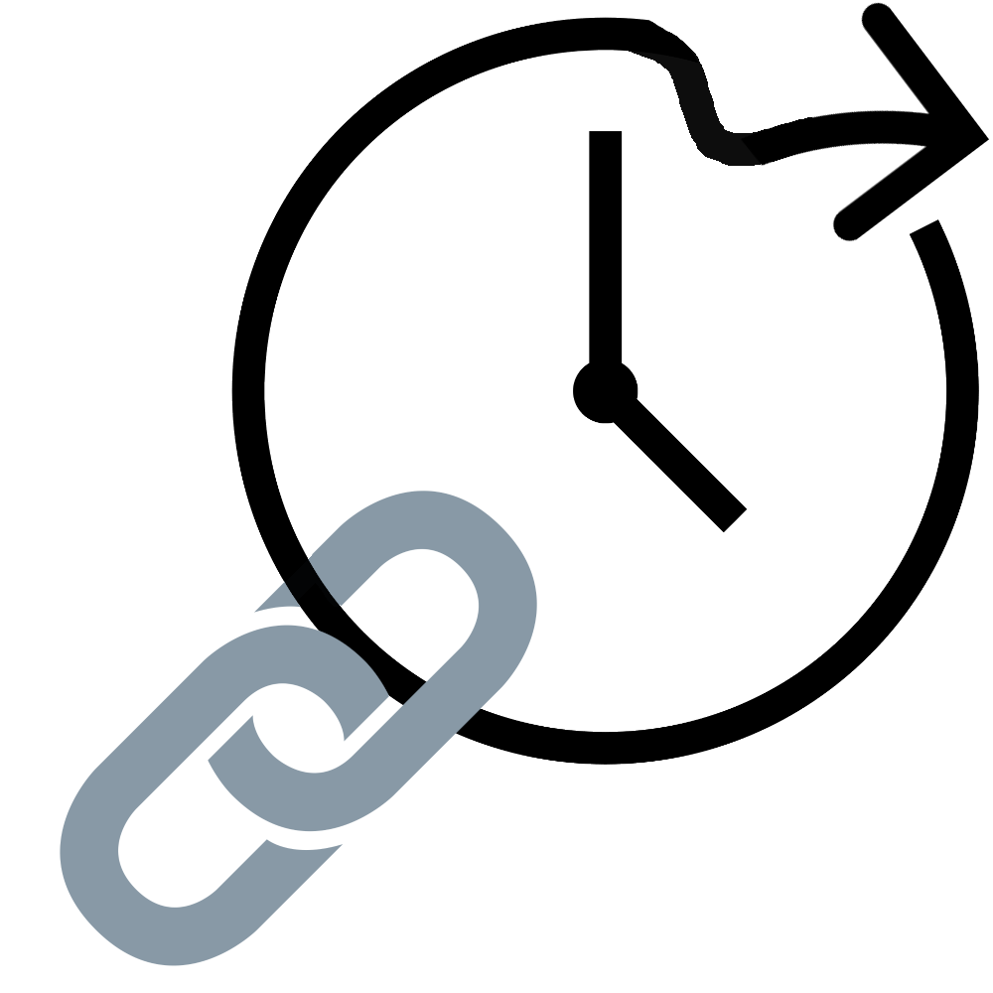
FutureLink
Aaron, Ben, Bryant, Antonio

Slide 2

First, a question for the class:
How does a robot eat a pizza?

Slide 3
One Byte at a time!

Slide 4
Now that we have everyone's attention: What is new with FutureLink?
Our last meeting concluded with an unstructured jumble of code, created, but incomplete GUIs, and a timeline for what is to come.
Today, we have a 100% complete demo of the full scope of the project.
Aside from minor tweaks, optimization, and ironing, what we have today is a completed vision of the project.

Slide 5
Before we get to that…
We have some very cool backend features that aren’t obvious in the demo on how exactly they work. This PowerPoint seeks to shed light on those features.
Such as....

Slide 6

Login Encryption
To ensure the security of the users of FutureLink, we store an encrypted version of the user's password in the database. Using the ‘ROT-13’ Encryption method, if the data inside of the database were to be exposed, the user’s personal data would be preserved this way.
AaronScott2025 | Farmingdale14@

Slide 7
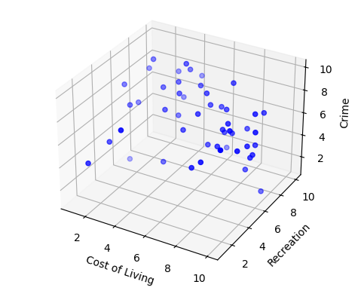
Nearest Neighbors Algorithm (Relocation Function)
Using a predictive algorithm, known as “KNN” or “’K’ Nearest Neighbors”, we use parameters from the user to get a datapoint, then use Euclidean Distance to calculate the distance between that point, and the others in our dataset. We modified it to produce the top 3 and bottom 3 states that resonate most with your ideals based on only a few questions!

Slide 8

GPT 4-o (Career/Education Advising)
Utilizing the latest GPT model, we developed an advisement bot to give any advice needed in an education or workforce context.

Slide 9
Quickchart.io
We used this API in our Investment’s function, and our Budgeting function, to provide the user with an easy-to-read chart of their data. We used a line graph in our investments function, and a Pie Chart in our budgeting function.

Slide 10

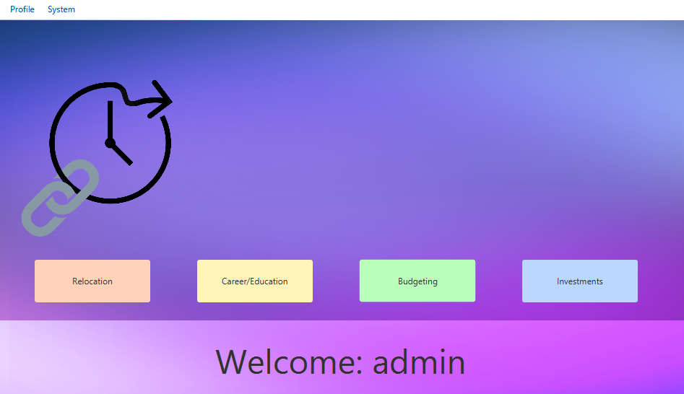
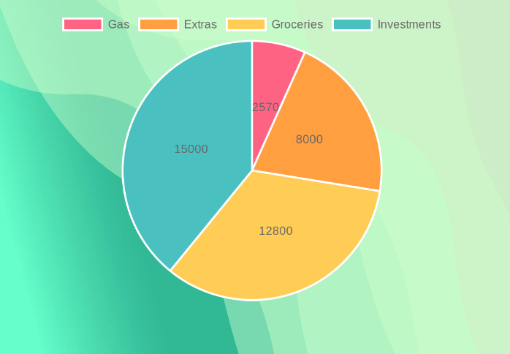
Design Philosophy
We went for a pastel theme, as we found it to ease the user into a relaxed state of mind. We further utilized this theme in each of the GUIs for our functions, with the button corresponding to a function being colored the same way the background is of the function’s GUIs.

Slide 11
Without Further Ado
We will now begin our demo

